Slide 1
E-COMMERCE DASHBOARD

Slide 2


TEAM PRESENTATION
AARSH SAPRA AUTHOR 1
RACHIT AGARWAL AUTHOR 2

Slide 3
Introduction
1
Objectives ,architecture and procedures.

Slide 4
The greatest value of a picture is when it forces us to notice what we never expected to see.

Slide 5
OBJECTIVE
To analyze the given sales data for the company , and create a story to visualize points of interest and highlight the areas of concern , while allowing the user to interact with the dashboard to draw unique insights himself.

Slide 6
BENEFITS
The company can easily understand the underlying trends in sales without processing 1000’s of spreadsheets.
The questions put up by the board of directors can be easily addressed using filters and processing queries.
The project scales well to new data entries and thus can be reused in the future.

Slide 7
DATASET DESCRIPTION
E-commerce Dashboard.xlsx file provided by ineuron.
Dataset has 21 columns and 51291 rows.
Contains information about product sales , profit , discount , shipping costs in usd.
Information about customer name , product ordered , its category , location of the customer and its segment as string.
Order and Dispatch date in datetime format.

Slide 8
WORKFLOW DIAGRAM

Slide 9
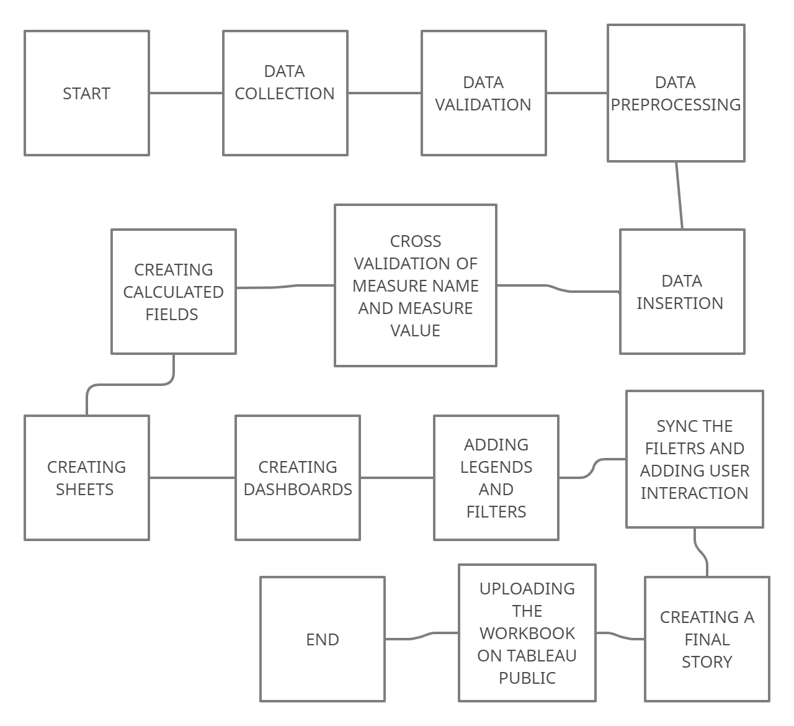

Slide 10
DATA VALIDATION AND PREPROCESSING
Dataset has no missing values.
Aging Validation: Order Date - Ship Date = Aging. Consistent throughout the dataset.
Cross Validation of categorical columns to find any inconsistencies. No anomalies detected.

Slide 11
Data insertion into Tableau
Note: Mysql database connection is unavailable in Tableau public free
We can directly open the excel file in tableau.
Then we extract the data from the file creating a local data source in Tableau for the given project.
Once data is inserted we get measure names - discrete and categorical values
And measure values - continuous values to plot our visualizations

Slide 12
Calculated Field into Tableau
Profit % - SUM[Profit]/SUM[Sales]
IS Business Day - We use DATEPART method on order date , to find the day on which order is shipped and classify it as business day (for weekday) and not business day (weekends)
Shipment status - We first assign the stipulated number of days it should take for the product to be shipped by using the general convention in ship mode.
For ‘Same Day’ - 1 , ‘First Class’ - 3 , ‘Second Class’ - 5 , ‘Standard Class’ - 7
We then compare it with the Aging , to decide whether order is shipped early, late or on time.

Slide 13

A PICTURE IS WORTH A THOUSAND WORDS
Processing many records in a spreadsheet becomes easier when you visualize it in a graph
New insights from different perspectives .

Slide 14
We create three dashboard each highlighting a different aspect of the business.
From these we build an interactive story that lets user draw their own insights while we highlight the relevant features that intrigued us while working on the dataset.

Slide 15
SALES OVERVIEW
Our first Dashboard aims to give a brief overview of the sales of the company for the year 2015.
First we create a geographical map by dropping the auto-generated latitude and longitude filed , and use color to compare amount of sales across different countries
Second we create a dual axis bar- line chart to compare total sales and sales of each product category on a monthly basis.
Lastly we have a bar chart showing monthly sales across different segments.
We add filters for product category , segment , country , region and a filter for quarterly basis analysis.

Slide 16
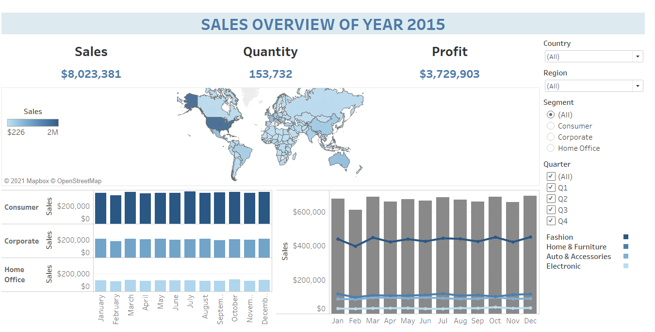

Slide 17
PROFIT OVERVIEW
Our second Dashboard highlights the profit earned by the company for each individual countries.
First we create a donut chart which represent the profit earned by each product category over the three segments.
Second we create a geographical map which show the details of the specific country.Thus we can get a higher level of detail by analyzing the profit across each state for the country of interest.
Lastly we have a horizontal bar chart showing top 10 most profitable products .
We add filters for month of the order date, country , region , segment.
We use product category as a context filter to sync the bar chart for most profitable products based on category.

Slide 18
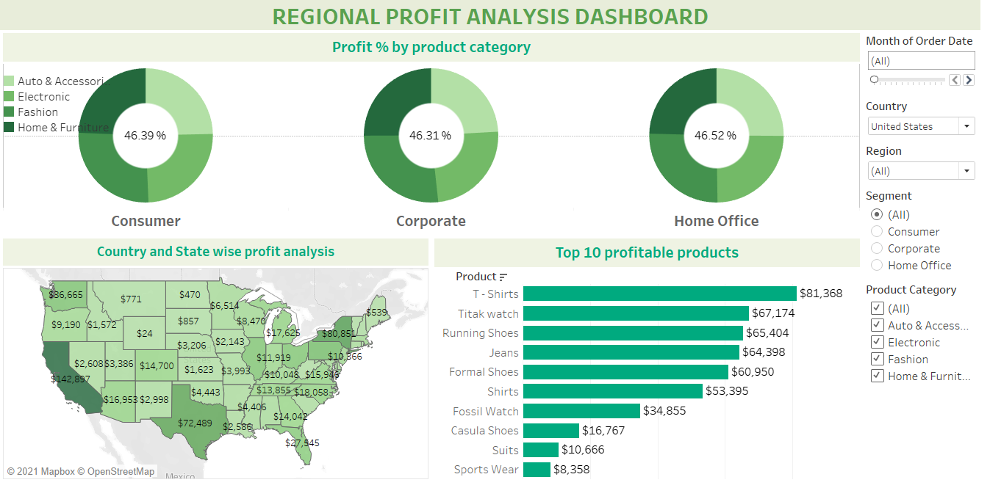

Slide 19
PRODUCT OVERVIEW
Our final Dashboard tries to analyze products based on different columns of the dataset
Firstly we create a table with ship mode as columns and order priority as rows and quantity of products as the value.
Secondly we create a bubble chart for product category and shipment status.
Third we have an area chart for different segments across all the months to see which segment buys the most.
Lastly we have top 10 discounted products.
We add filters for product category , order priority , ship mode, true and false filter for business day and a filter to analyze data on quarterly basis.

Slide 20
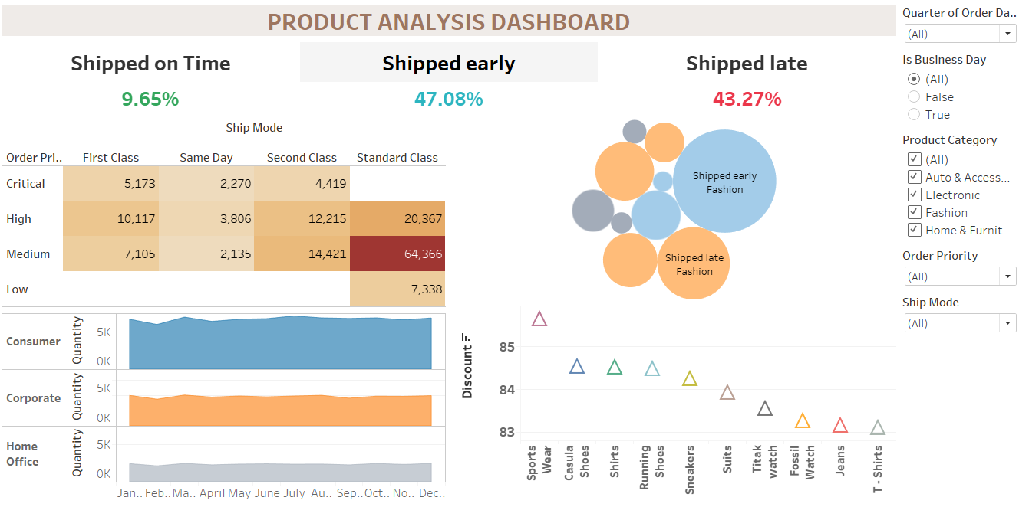

Slide 21
TREND ANALYSIS
2

Slide 22
3,729,903$
153,732 items
8,023,381$ sales
That’s a lot of money
And a lot of ordered products
Total success!

Slide 23
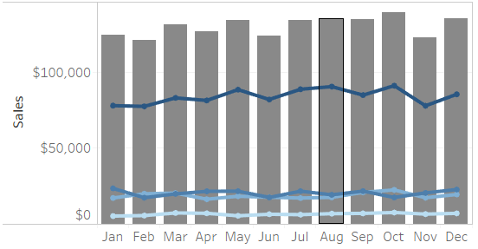

TRENDS IN SALES
We find that United States of America is the highest contributor with $1,562,170 worth in sales.
Consumer segment alone amounts to more than 50% of the sales.
Fashion leads the sales in product categories and electronics are the least sold products.
The monthly or quarterly sales are spread evenly across the year.

Slide 24
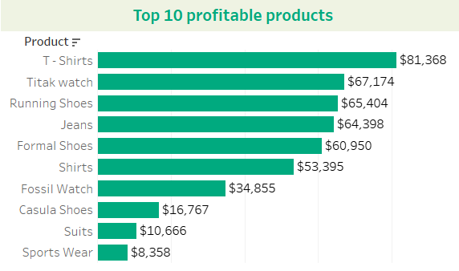
TRENDS IN PROFIT...
As an inference from the visualization, we can conclude that most of the products belong to Fashion category.
The profit percentage across all the three segments is uniform.
Western region in U.S.A has the highest profit margin.
Maharashtra is the highest profitable state in India followed by Uttar Pradesh with profit of $20,810 & $15,634 respectively.

Slide 25
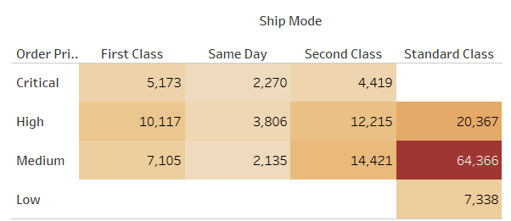
TRENDS IN QUANTITY...
Orders with medium priority were shipped majorly through standard class.
None of the products in Electronics category were shipped on time thus affecting their sales.
Fashion products were heavily discounted hence the the higher sales.

Slide 26
THANKS!
REGARDS:
AARSH SAPRA
RACHIT AGARWAL

